Slide 1
CTRL-Z: MACHINE LEARNING PROJECT
Fake Article Detection
Muntaha Pasha, Erik Pohle, Nick Julander, Everett Kirkpatrick, Yair Bennaim
Notes:
Yair

Slide 2
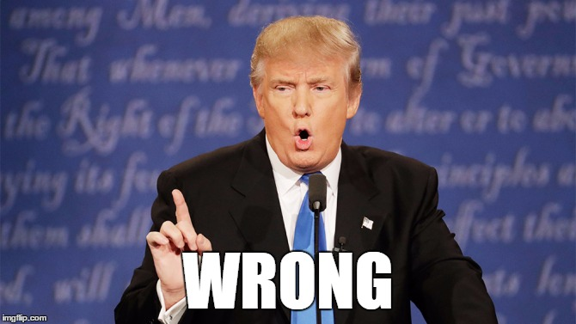
The Problem
With the advent of the 2020 Elections, it’s clear that fake news has every ability to run rampant across different social media platforms. As such, it’s more important now than ever to have proper ways of classifying the legitimate news from the fake news.
Our goal was to create a ML model that would have a high accuracy when categorizing the real news from the fake news.
Notes:
Yair

Slide 3
Approach
We settled on using a LSTM model with 7 layers for classifying fake news and real news.
To process the data, we dropped all Null articles as well as all articles with less than 50 characters.
We then tokenized all articles and padded the sequence length so every article is the same length.
Experimented with different filters, e.g. ignoring all punctuation.
Notes:
Everett

Slide 4
Reasons for Approach
First, we started off by finding a simple dataset to use. We wanted to minimize our time spent gathering the data so we could focus on the actual ML implementation.
After the data was collected, we began performing some data analysis to find some key differences between legitimate articles and fake articles.
After we recognized some trends and found our key features, we began using a Naive Bayes solution as a starting point. While the accuracy score wasn’t that high for differentiating between fake and real articles, the Naive Bayes solution provided key insights into which features we need to use and which are redundant.
After some research, we landed on using LSTM as our model. The reason behind using LSTM was because an RNN model would have to deal with the vanishing gradient problem. Another benefit of using LSTM was because they are well suited for classifying events that occur in a time series.
Notes:
Erik - last two points
Everett - first two points

Slide 5
Major Findings
We decided that the LSTM model has the best accuracy score for categorizing fake news and real news. (The Naive Bayes and RNN model were both worse and the RNN model encountered the vanishing gradient problem)
We tested the LSTM model with multiple different optimizers and decided that the ADAM optimizer performed the best in our case.
Notes:
Erik

Slide 6
Accuracies w/ Optimization and Loss
1 Epoch - Sample Size 16,443
LSTM Model, these were the optimizers provided.
Using Sparse Categorical Cross Entropy as Loss.
ADAM - Loss of 0.25, Accuracy of 0.91 ← 1st Place!
ADAMAX - Loss of 0.33, Accuracy of 0.88
ADADELTA - Loss of 0.46, Accuracy of 0.83
ADAGRAD - Loss of 0.56, Accuracy of 0.74
SGD - Loss of 0.69, Accuracy of 0.53
Notes:
I will be discussing some of the Optimization Techniques we used on our LSTM Model. For our loss function we used Sparse Categorical Cross Entropy which is used for classes that are mutually exclusive (e.g. when each sample belongs exactly to one class). We tried other loss functions like Binary Cross Entropy, but did not get good accuracies for our model with those.
Adam is an extension that can be used in place of SGD to train a model and relies on properties from the optimizers of AdaGrad and RMSprop. It works best when you handle problems with lots of potential noise, and in our case we saw drastic improvements when using Adam instead of just the usual SGD.
Our optimizations were conducted using 1 Epoch and a sample size of 16,443 which averaged around 35-40 minutes to run on JupyterLab. Using a normal SGD optimizer, we got a loss of 0.69, and an accuracy of 0.53 which was our worst performing optimizer. We knew that this was around a baseline score of 50%, so it was time to do some improvements using these different optimizers.
Using Adam, we got a loss of 0.25, and an accuracy of 0.91. Along with using Adam, we decided to try a variety of other Optimizers, ranging from Adagrad, (an algorithm for gradient-based optimization that adapts the learning rate to the parameters and thus performs smaller updates) to Adadelta (a more thorough, and robust extension of Adagrad that adapts learning rates based on a moving window of gradient updates, instead of just accumulating up all of the past gradients).
Using Adagrad, we got a loss of 0.56, and an accuracy of 0.74. With Adadelta, we got a loss of 0.46, and an accuracy: 0.83 which was A significant improvement from Adagrad, but still not as good as what we got using Adam. Finally, we tried one more Optimizer known as Adamax, an adaptive SGD method that offers the important advantage of being much less sensitive to the choice of the hyper-parameters (i.e, something like the learning rate).
Using Adamax, we did see some promising results as we got an accuracy typically around the mid to high 80’s range, but it still fell short to Adam. Our final loss and accuracy using Adamax was 0.33, and 0.88 - respectively.
To summarize, we noticed the best performance using LSTM with the Adam optimizer and Sparse Categorical Cross entropy for our loss function.

Slide 7
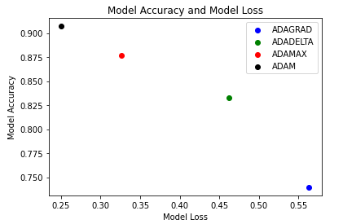
Notes:
Muntaha

Slide 8
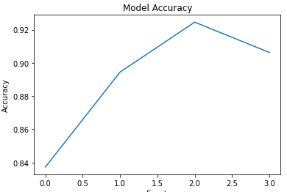
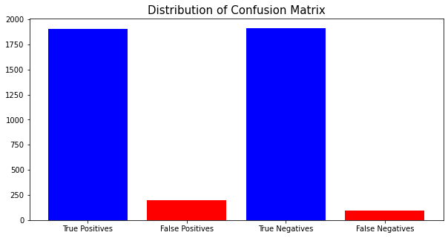
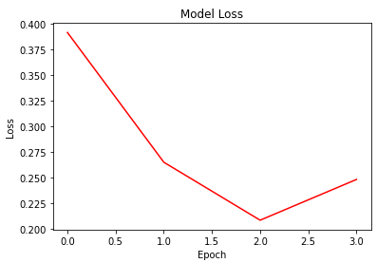
Model Performance Results
Notes:
So, onto our model performance.
For our model, a misclassified paper (i.e., fake news that is classified as not fake news) is an error.
The confusion matrix you see here was obtained from our model being ran on the test set (on this run, it obtained an accuracy of roughly 92%).
As one can see, there are slightly more false positive misclassifications than there are false negative misclassifications. So, more often an article is incorrectly labeled as non fake news than incorrectly labeled as fake news. Whether or not it is better to have a likelier chance of labeling fake news as real news, or vice versa, is highly debatable. However, reducing the number classiciations, whether false positive or false negative, should be the goal.
The accuracy model shows the accuracy the model the obtained over the course of 4 epochs. We see steady growth from the 1st to the 3rd epoch, and then a decline in the accuracy from the 3rd to the 4th epoch.
This decrease could likely be the result of over fitting, where our model may have focussed too much on noise of the training set causing it to be worse at generalizing and in turn getting a lower accuracy on the validation set.

Slide 9
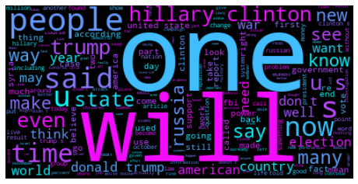
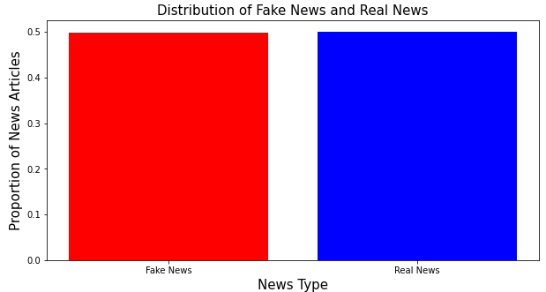
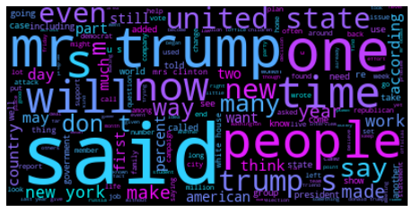
Data Insights and Results
Unreliable
Reliable
Notes:
The data we obtained was an evenly distributed set of fake and real news.
From the articles that were classified as fake news and real news, we generated two word clouds.
The word clouds had similarities, like frequency of the words “people” and “one”
Reliable articles use “said” more frequently than unreliable, and unreliable articles used “will” more than reliable articles.
Generally speaking, it seems that unreliable articles seem to be more opinionated and subjective based on the frequency of words that are commonly used in subjective statements, like “will.
Whereas, the reliable articles more frequently use words that appear in objective statements, like “said”.
Thank you all for your time, and we hope you enjoyed our presentation.

